Slide 1
Digital Signal Processing Experiment (DSP)
Project 2-Speech Enhancemnet(2/2)
Professor Fang Shih-Hao, Department of Electrical Engineering

Slide 2
Tutorial clip
Youtube turtorial
Youtube turtorial

Slide 3
NOISE
/01

Slide 4
Experiment tool
wienerscalart96.m
The code file of Wiener Filter.Input the speech files and other parameters to denoise
audio_SNR.m
Input clean speech and noise to produce noisy speech
noise.wav*3
Three different noises(horn、mouse and white noise)
clean speech.wav*10
10 clean utterences

Slide 5
Experiment tool
1
Provided
Clean speech
Noise
Mix noise program(audio_SNR.m)
Wiener filter
2
Reference document(word)

Slide 6
What is Frame?
1
Frame is the minimum unit of speech processing.
2
No certain size standard,you can customize it by uses.
3
Frame can calculate a speech feature value

Slide 7
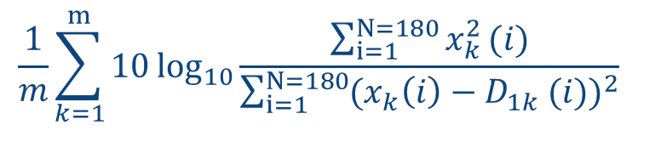

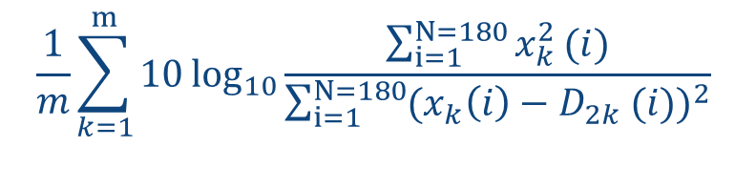
SNR (1/2)
1
SNR (Signal-to-Noise Ratio)
$$10{\log_{10}{\frac{\sum_{i=1}^{N=180}{x^{2}}(i)}{\sum_{i=1}^{N=180}{D2(i)}}}}$$
SNR:The ratio between the signal and noise
SSNR:The SNR value in every frame
𝑖 : The i-th value in the frame
2
SSNR (Segmental Signal-to-Noise Ratio )
The SSNR value of clean speech
after denoising
$$\frac{1}{m}\sum_{k=1}^{m}{10{\log_{10}{\frac{\sum_{i=1}^{N=180}{x_{k}^{2}}(i)}{\sum_{i=1}^{N=180}{{(x_{k}\left(i\right)−D_{1k} (i))}^{2}}}}}}$$
$$\frac{1}{m}\sum_{k=1}^{m}{10{\log_{10}{\frac{\sum_{i=1}^{N=180}{x_{k}^{2}}(i)}{\sum_{i=1}^{N=180}{{(x_{k}\left(i\right)−D_{2k} (i))}^{2}}}}}}$$
The SSNR value of noisy speech
3
SSNRI (Segmental Signal-to-Noise Ratio Improvement)
SSNRI=SSNR value of clean speech after denoising – SSNR value of noisy speech

Slide 8
SNR (2/2)
Variables | Meaning
X | Clean speech
D | Noise
D1 | The clean speech after denoising(Noisy speech after the wiener filter program)
D2 | Noisy speech (speech processed with `audio_SNR.m`)
N | Frame length (set to 180 for this project)
Y | Audio length
M | Number of frames = (Y/N), where any remainder is discarded.

Slide 9
Experiment Steps
1
Watch the tutorial video
2
Read the experimental theory in detail and understand the physical meaning of Wiener Filter and SNR
3
Experiment One&Two: follow the steps 1~5 in the word document
4
Complete Questions 1, 2 and 3 in the For Written Report section

Slide 10
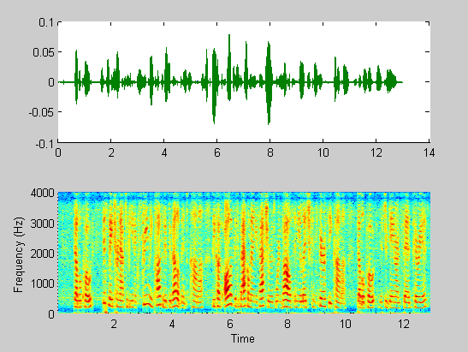
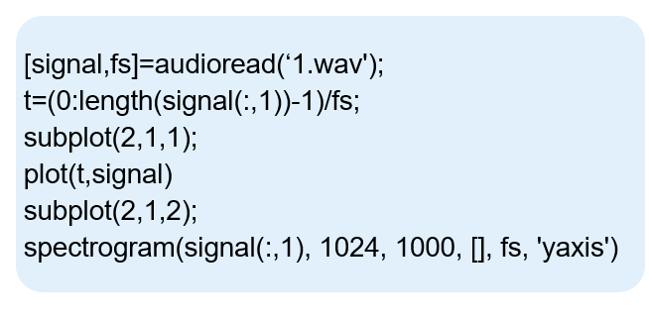
Additional information
★
Plot a spectrogram (Matlab)

Slide 11
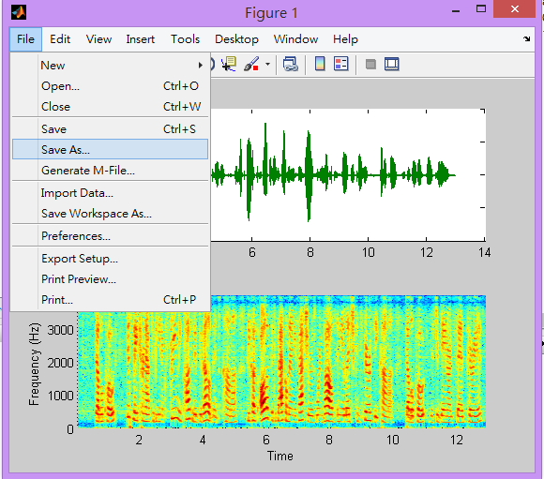
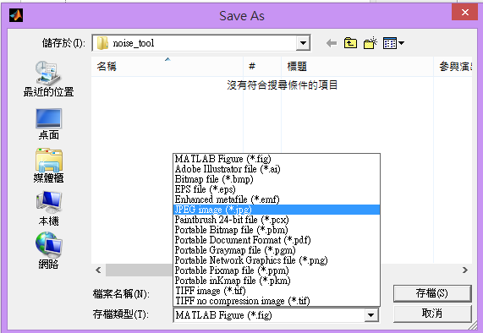
Additional information

Slide 12
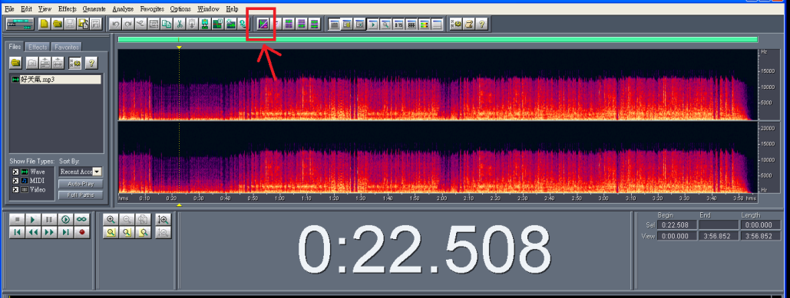
Plot a spectrogram (Cooledit)
★
cooledit
You can download the cooledit audio editing software to display the audio track spectrogram. Export the input and output spectrograms for comparison. Drop the audio file into cooledit and click on the icon to display the spectrogram.

Slide 13
ECHO
/02

Slide 14
Experiment tool
1
Provided
echo.m
LMS.m
Dataset
2
You can search for more
Other dataset
Other filters
3
Reference word document

Slide 15
Experiment Steps
1
Experiment Three: Generate and play echo (Demo)
2
Experiment Four: Use LMS.m to perform echo cancellation (Demo) and observe MSE
3
Experiment Five: Update NLMS
4
Complete Questions 4, 5 and 6 in the For Written Report section

Slide 16
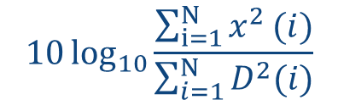
Experiment One(1/2)
Experiment One
Practice audio file loading, playback and mixing noise
Refer to the WORD → Experimental steps: Steps 1 and 2
Hint: (1) signal-to-noise ratio = 5
Complete audio_SNR.m according to the comments next to audio_SNR.m, making it a program that can mix clean speech with noise.
1
Use audio_SNR.m to mix existing noise files, adjust the signal-to-noise ratio and set the output time in seconds.
2
SNR:the ratio of signal to noise
$$10{\log_{10}{\frac{\sum_{i=1}^{N}{x^{2}}(i)}{\sum_{i=1}^{N}{D^{2}(i)}}}}$$
(X is the clean speech, D for noise, N is the length of the speech)
[output,fs]=audio_SNR('Clean file.wav' , 'Noise file.wav’, SNR);

Slide 17
Experiment One(2/2)
Experiment One
Practice audio file loading, playback and mixing noise
Refer to the WORD → Experimental steps: Steps 1 and 2
Hint: (1) signal-to-noise ratio = 5
Using the commands wavread and sound, you will get the two variables signal and fs of the voice signal and sampling frequency.
3
[signal,fs]=audioread(‘file.wav’); %Read the wav file (remember that the wav file and the program file must be in the same directory)
sound(signal,fs); % Play wav file
Play the mixed voice sound to see if there is any effect

Slide 18
Experiment Two
To remove noise and save the denoised speech.
Follow the steps in the lecture notes for step 3~5.
Set the noise sampling duration to s = 0.5 seconds.
Experiment Two
To remove noise from the speech signal using a Wiener filter, use the `wienerscalart96.m` script. Input the signal variable `output`, the sampling frequency `fs`, and the noise sampling duration `s` (recommended to be between 0 and 1). This will apply the Wiener filter to the speech signal to remove noise.
1
output1=WienerScalart96(output,fs,s);
sound(output,fs);
2
Use `audiowrite` to write our `output` as a WAV file. You can set the output path and filename yourself.
audiowrite( Filename, output1, fs);

Slide 19
Experiment Three: Generate and play echo
Please refer to the Project 1 experiment procedure: Experiment Three
★
For this experiment, we will use the `echo.m` tool to generate room echo.
★
This code includes tools for Room Impulse Response Generator (RIRG). You input various
parameters (room size, speaker position, microphone position, number of reflections, etc.),
and RIRG generates the Impulse Response (h) of the room. Afterwards, you convolve h
with the input audio to generate the echo of the room.

Slide 20
Experiment Four: Use LMS.m to perform echo cancellation (Demo) and observe MSE
Please refer to the Project 1 experiment procedure: Experiment Four
★
Using the provided LMS.m program, observe the estimated impulse response (ℎ ̂) of the filter
and the impulse response (ℎ) simulated by RIRG. You can use the `hold on` command taught
earlier and change the color to compare the two. The closer they are, the more accurate the
estimated ℎ ̂ of the filter. In this program, w represents ℎ ̂, so please select the last row to plot.
★
When conducting this experiment, considering hardware limitations and for future experiment
convenience, the parameters cannot be self-set. Please input the parameters according to the
following table. Use Gaussian noise as the input audio.
★
Use the Mean Squared Error (MSE) to observe the error between ℎ and ℎ ̂. A smaller MSE
indicates a smaller difference between the two, indicating better echo cancellation. The program
to calculate MSE is already written in LMS.m, so you only need to plot it and observe.

Slide 21
Experiment Five: Update NLMS
Please refer to the Project 1 experiment procedure: Experiment Five
Regarding echo cancellation filters, LMS is just one type. Apart from LMS, there are other filters with better performance.Therefore, in Experiment Four, we will modify the LMS algorithm within the full_lms.m file, updating it to NLMS.This will allow us to compare the performance of the two filters in estimating ĥ and MSE, and evaluate their respective advantages and disadvantages.
★
★
Hint: You can start by comparing the filtering algorithms of the two filters
provided in the Appendix section on page 16-18 of the lecture.

Slide 22
For Written Report
Save the audio file after removing the noise using wienerscalart96.m (student ID) and upload it.
(Use the clean speech file 2.wav mixed with the horn noise, with a signal-to-noise ratio of 5)
Q1
For Written report: Please use clean speech 1.wav and three types of noise (signal-to-noise ratio = 5). For each type of noise, plot the waveform and spectrum plots for both the clean speech and the noisy speech, and compare the differences (1x3x2x2=12 plots).
Utilizing Experiment Five, write a short program to automate the process of quantizing 10 clean speech files against 3 different noise types (horn, mouse, and white noise), 2 signal-to-noise ratios (10, 50), noise sampling duration s = 0.5, N=180, for a total of 60 combinations. Create a table to present the data. Please observe and compare the data, and provide an explanation.
Q2
For example: When using clean speech '3', noise type 'horn', and signal-to-noise ratio of 10, the quantized value obtained is 11.546.

Slide 23
For Written Report
Adjust the parameters *IS, W, and SP in wienerscalart96.m to improve the performance of the Wiener Filter in noise reduction. Create the same table as in Question Two, and observe and compare the quantified values before and after modifying the parameters in wienerscalart96.m.
Q3
For each parameter nn, a, and rm in Experiment 3, input different values and plot h. Describe the changes and the perceived echo for at least three different combinations. (e.g., How does increasing nn affect the result? What happens if a is set to -1?)
Q4
Please try at least three different combinations of parameter values and describe the
differences between them.

Slide 24
For Written Report
Please enter different values of μ (step size) to observe the convergence behavior of MSE and the "impulse response" ℎ ̂.
Q5
At least compare the MSE under three different μ values (large, medium, small). (And explain whether increasing or decreasing the μ value affects the convergence speed of MSE? What happens if it is too large? What happens if it is too small?)
Compare the differences between LMS and NLMS (convergence of MSE, performance when input is changed to speech).
Q6
What is the convergence behavior of LMSE? If the input is changed to an audio file, which would perform better?

Slide 25
Scoring Criteria
Item | Scores | Description
Written Report | 80% | The report accounts for 80% of your grade, with each experiment contributing 10% and each question discussion contributing 5%.
Matlab files & Audio files | 20% | Please upload the code to the portal by December 10th and the audio file for Question One on November 26th.

